Slide 1




TRACK2CAREER
FYP ACCEPTANCE
9 NOVEMBER 2018

Slide 2
AGENDA
01
Introduction
02
Problem & Solution
03
Demo
04
Project Plan
05
X-Factor
06
Learning Outcome
Introduction
Problem & Solution
Demo
Project Plan
X-Factor
Learning Outcome

Slide 3
INTRODUCTION
Members. Stakeholders.

Slide 4

TEAM MEMBERS
JIN LIM
Back End Developer
Assistant Project Manager
ASHLEY TAN WEI ZHENG
Project Manager
Assistant Quality Assurance
TAN ZER DONG
Front End Developer
Quality Assurance
REGAN SEAH
Back End Developer
Back End Integration
XU HAONAN
Front End Lead
Front End Integration
Introduction
Problem & Solution
Demo
Project Plan
X-Factor
Learning Outcome

Slide 5

PROJECT STAKEHOLDERS
Students
Living Analytics Research Centre
SMU School of Information System Management
Introduction
Problem & Solution
Demo
Project Plan
X-Factor
Learning Outcome

Slide 6
PROBLEM & SOLUTION
Problem. Workflows. Solution. Technologies.

Slide 7



PROBLEM STATEMENT
Career planning is an important life milestone
It is a daunting task for students and young adults alike
Current resources (DKHMCC, OnTrac, online research) take a lot of time and/or do not specifically provide a guided roadmap
Introduction
Problem & Solution
Demo
Project Plan
X-Factor
Learning Outcome

Slide 8

MISSION
CELINA KOH
Career Strategist
WENDY TAN
Senior Instructor
Track2Career is spearheaded by SMU’s very own School of Information Systems (SIS).
SIS understands that career-planning is a daunting task to young adults and working professionals alike. The development of Track2Career will equip users with a powerful tool that demystifies and simplifies the career-planning process.
Introduction
Problem & Solution
Demo
Project Plan
X-Factor
Learning Outcome

Slide 9




TRACK2CAREER
THE SOLUTION
Explore opportunities, courses and skills presented by each academic track
Provide a guided, actionable road map towards your dream job
Skills and wage analytics dashboard intuitively present valuable information
Allow system administrators to efficiently manage new track and courses
Introduction
Problem & Solution
Demo
Project Plan
X-Factor
Learning Outcome

Slide 10
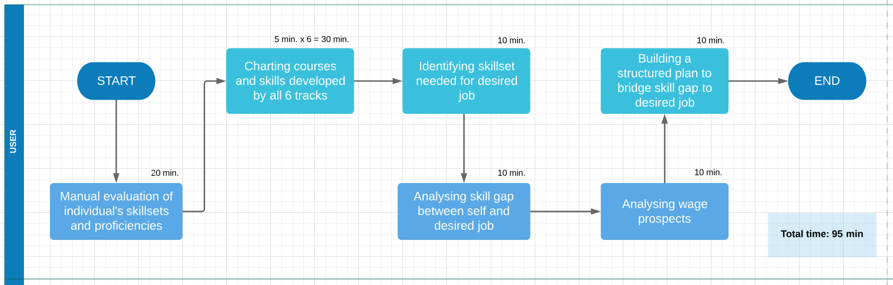
AS-IS WORKFLOW
Introduction
Problem & Solution
Demo
Project Plan
X-Factor
Learning Outcome

Slide 11
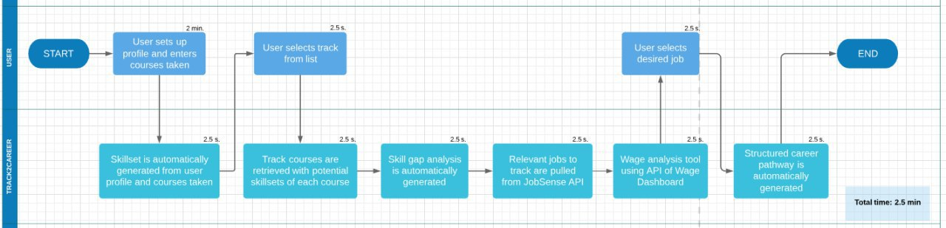
TO-BE WORKFLOW
Introduction
Problem & Solution
Demo
Project Plan
X-Factor
Learning Outcome

Slide 12



SAMPLE REPORT
JOHN DOE
YOUR ACADEMIC TRACK:
YOUR DREAM JOB:
SMU SIS Year 3 Student
BUSINESS ANALYTICS
DATA ANALYST
[Mouseover] 40% of users with a skill set similar to yours have this job!
The average salary for this job is $3800
SKILLS ANALYSIS
JOB ANALYSIS
[Mouseover] This skill can be obtained from:
IS424: Data Mining
Acquiring this skill will raise your potential salary by $200
[Mouseover] You have 23 out of 31 required skills for this job.
The average salary for this job is $3800
Data visualization
Sentiment analysis
Business analyst
Clustering analysis
Downsampling
Process improvement analyst
Data preprocessing
Decision tree
Topic modelling
Ensemble methods
Security analyst
Introduction
Problem & Solution
Demo
Project Plan
X-Factor
Learning Outcome
Notes:
Blue boxes can pop out on-click

Slide 13
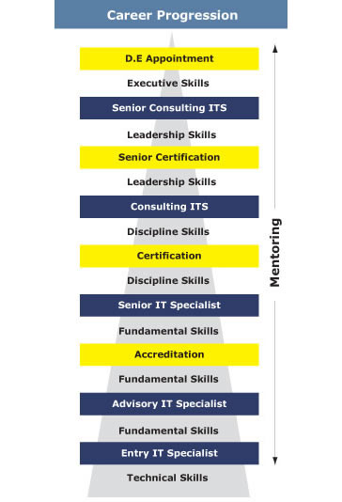
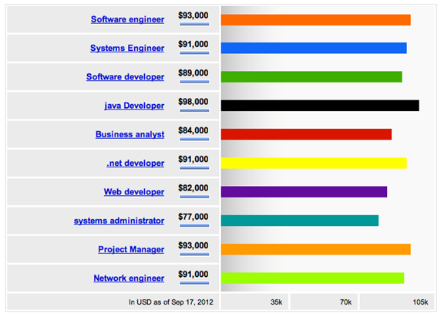
WAGE ANALYTICS
Introduction
Problem & Solution
Demo
Project Plan
X-Factor
Learning Outcome

Slide 14
PROJECT TIME-SAVINGS
Manual Process | Time (min) | Track2Career | Time (min)
Manual evaluation of individual’s skillsets and proficiencies | 20 | User sets up profile and enters courses taken | 2
Charting courses and skills developed by all 6 tracks | 5 x 6 = 30 | Skillset is automatically generated from user profile and courses taken | 0.04 (2.5s)
Identifying skillset needed for desired job | 10 | User selects track from list; Track courses are retrieved with potential skillsets of each course | 0.08 (5s)
Analysing skill gap between self and desired job | 10 | Skill-gap analysis is automatically generated; relevant jobs to track are pulled from JobSense API | 0.08 (5s)
Analysing wage prospects | 10 | Wage analysis tool using API of Wage Dashboard; User selects desired job | 0.08 (5s)
Building a structured plan to bridge skill-gap to desired job | 15 | Structured career pathway is automatically generated | 0.04 (2.5s)
 | TOTAL: 95 minutes |  | TOTAL: 2.5 minutes
Introduction
Problem & Solution
Demo
Project Plan
X-Factor
Learning Outcome

Slide 15














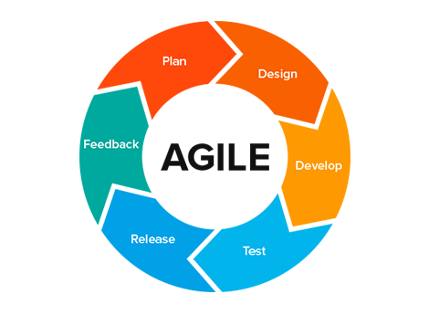


TECHNOLOGIES USED
Client Side
Servers
Project Management
Repository
Development
Introduction
Problem & Solution
Demo
Project Plan
X-Factor
Learning Outcome

Slide 16
DEMO
Persona. Scenarios. UAT Results.

Slide 17
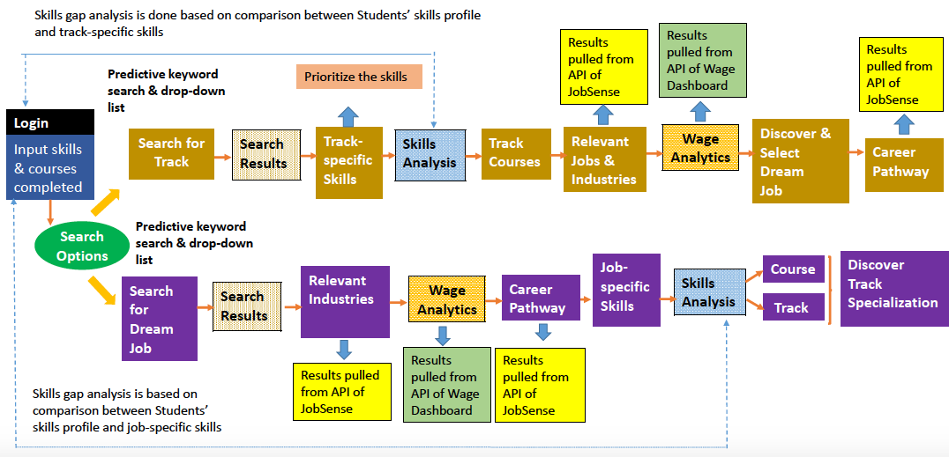
SCOPE OF TECHNICAL DEMO
Introduction
Problem & Solution
Demo
Project Plan
X-Factor
Learning Outcome

Slide 18

PERSONA
Name: Adam Chang
Age: 21
Profession: Student
Year Of Study: 2
Major: Information Systems
with No Track
Tech-savviness: Advanced
Goals:
Wants to declare an academic track that will lead into professional development and desirable careers
Wants to understand the opportunities provided by each track
Wants information to be easily understandable
Introduction
Problem & Solution
Demo
Project Plan
X-Factor
Learning Outcome

Slide 19
SCENARIO – SEARCH FOR TRACK
01
As a 2nd Year IS student, Adam has to eventually declare an academic track soon, and needs to decide on one out of the 6 available tracks.
Previously he tried to do some planning, but the process was long and tedious as he wanted to understand how are the wages, career progression and skills requirement for a few jobs he has shortlisted which relate best to the individual track within the requirements
With the implementation of the Track2Career portal, Adam will first register with his particulars followed by logging into the portal
Upon gaining access, he inputs the courses he has taken into the page
02
03
04
Introduction
Problem & Solution
Demo
Project Plan
X-Factor
Learning Outcome

Slide 20
SCENARIO – SEARCH FOR TRACK
05
Following that, he can select the track option and search for the available track
The search results will display all track relevant skills as well as the skills gap the student has in relation to the track
To help cover the skills gap, the student will be able to view relevant track courses that will help him to fill the gap
Following that, he can view relevant jobs as well its respective wage details
As he selects the job option, it will display the career pathway of the job
06
07
08
09
Introduction
Problem & Solution
Demo
Project Plan
X-Factor
Learning Outcome

Slide 21

PERSONA
Name: Amy Tan
Age: 22
Profession: Student
Year Of Study: 3
Major: Information Systems
with Financial Technology Track
Tech-savviness: Advanced
Goals:
Has interest in the FinTech sector and has chosen the relevant track
Wants to find out what kind of job suits her best given her current skillset
Introduction
Problem & Solution
Demo
Project Plan
X-Factor
Learning Outcome

Slide 22
SCENARIO – SEARCH FOR CAREER
01
As a student, Amy is looking to find a dream job that she can set as a goal, however she does not know exactly where to start from
With the implementation of the Track2Career portal, Amy will first register with her particulars followed by logging into the portal
Upon gaining access, she inputs the courses she has taken into the page which will generate her existing skillsets
Following that, she can select the career discovery option and search via keywords. In addition, a recommended job according to her skillset will also be displayed
02
03
04
Introduction
Problem & Solution
Demo
Project Plan
X-Factor
Learning Outcome

Slide 23
SCENARIO – SEARCH FOR CAREER
05
The search results will display all relevant jobs according to the keyword entered by her
When the user selects the job, details of the relevant industries, wage details and career pathway for the job will appear
As he progresses within the portal, a skills analysis will be shown regarding the important skills that have been and have yet to be acquired
Regarding the skills that have yet to be acquired, the system will provide relevant track course recommendations to the student as well as the relevant tracks which these courses belong to
She selects a specialization and explores the details further
06
07
08
09
Introduction
Problem & Solution
Demo
Project Plan
X-Factor
Learning Outcome

Slide 24


UAT 1
Participants: 5 Students
Venue: SMU Labs
Duration: ~10 minutes per user
Introduction
Problem & Solution
Demo
Project Plan
X-Factor
Learning Outcome

Slide 25

UAT RESULTS
Study Goal | Completed
Users should be able to sign up for a new account | ✓
Users should be able to sign in with an existing account | ✓
Users should be able to input their courses taken and skills under profile information | ✓
Users should find it easy to navigate through the application | ✓
Users should find the application design intuitive | X Improve User Interface in Search Results Page
Users should be able to search using keyword without guidance from a test facilitator | ✓
Users should be able to view search information without guidance from a test facilitator | ✓
Introduction
Problem & Solution
Demo
Project Plan
X-Factor
Learning Outcome

Slide 26
PROJECT PLAN
Scope. Timeline. Architecture. Risks.

Slide 27
PROJECT SCOPE
Core
Functions
Secondary
Functions
Good to
Have Functions
Accounts Module
User Login / Logout
Collects profile information (e.g. skills and courses
Analytics Module
Perform comparison between user’s skill profile and requisite skillset for dream job
Retrieve information from the API of JobSense and display relevant jobs, industries and career pathway
Retrieve information from the API of Wage Dashboard and display wage analysis
Administrative Module
Upload CSV file to update track, course and skills
Track Discovery Module
Perform search with suggestive dropdown list
Highlight track-specific skills by weightage
Skills gap analysis
Career Discovery Module
Perform search with suggestive dropdown list
Highlight job-specific skills by weightage
Skills gap analysis
Accounts Module
Access control
Password hashing
Accounts Module
SSL
Facebook and LinkedIn Login
Track Discovery Module
Predictive search incorporated with dropdown list
User guide
Notification Module
In-app notifications
Routine reminders
Set email notification triggers
Career Discovery Module
Predictive search incorporated with dropdown list
User guide
Contact Module
Make an appointment with track/career advisor
Analytics Module
Exportable Reports
Render graphs for summary report
Introduction
Problem & Solution
Demo
Project Plan
X-Factor
Learning Outcome

Slide 28


ARCHITECTURE
X
Web Application
Front-End
Back-End
Students
Admin
Tools Used
Hosting
Version Control
Development Tools
Database
Application Hosting
Introduction
Problem & Solution
Demo
Project Plan
X-Factor
Learning Outcome

Slide 29
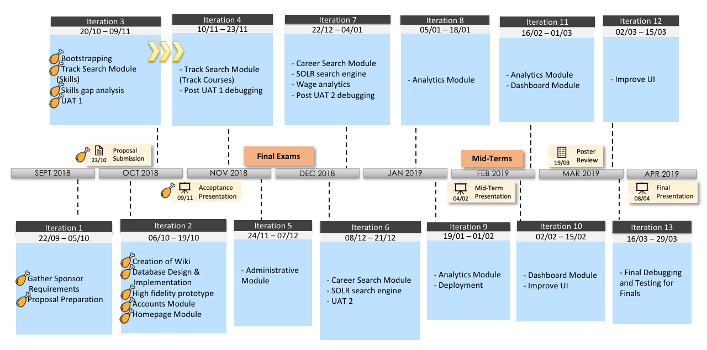

PROJECT TIMELINE
Introduction
Problem & Solution
Demo
Project Plan
X-Factor
Learning Outcome

Slide 30
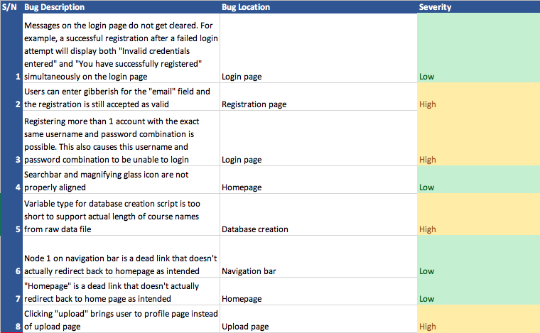
BUG METRICS
ITERATION 2
Introduction
Problem & Solution
Demo
Project Plan
X-Factor
Learning Outcome

Slide 31
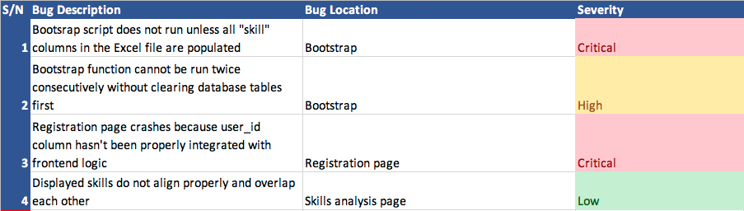
BUG METRICS
ITERATION 3
Introduction
Problem & Solution
Demo
Project Plan
X-Factor
Learning Outcome

Slide 32
RISK MANAGEMENT
Risk Type | Risk Event | Probability | Impact | Mitigation
Client Management | Client’s requirements may change or fail to meet expectations of client | Medium | High | Meet clients every week to update progress and receive feedback on improvements
Technical Capabilities | More time might be required to explore new technology, affecting progress and the ability to meet stipulated deadlines. | Medium | High | Perform prior research. Seek help from mentors. Constantly review and re-evaluate project schedule.
Resource Limitation | Team members may fall ill during the project or resources may fail. (Unforeseen circumstances) | Low | High | Each team member is assigned a deputy role for, in the event that the lead is unavailable.
Introduction
Problem & Solution
Demo
Project Plan
X-Factor
Learning Outcome

Slide 33




STRESS METER
Rating 1 to 5 on Stress Meter
(1 being happy, 5 being stressed)
Ashley:
3 /5
5: Stressed
Jin:
3 /5
3: Healthy
Zone
Regan:
3 /5
Zer Dong:
2.5 /5
1: Happy
Haonan:
2.5 /5
Introduction
Problem & Solution
Demo
Project Plan
X-Factor
Learning Outcome

Slide 34
X-FACTOR

Slide 35


X-FACTOR
MANUAL PROCESS
TRACK2CAREER
90 MINUTES
3 MINUTES
Track2Career generates a robust and intuitive career plan within 3 minutes and is easily revised and customized to a user’s progression and changing needs.
Most career guides’ outlines take anywhere from 90 minutes to several weeks to complete. (Todd, 2017)
Introduction
Problem & Solution
Demo
Project Plan
X-Factor
Learning Outcome
Notes:
Celina agrees that manual process takes 90 mins

Slide 36
LEARNING OUTCOME

Slide 37



LEARNING OUTCOME
• Technical depth is important but understanding the business case is paramount
• The true goal is to design a system that makes life easier for users, technology is just an enabler to achieve this goal
• Creating a solution to a problem that is beautiful in both presentation and execution
• Prototyping allows the team and clients to identify the unknowns.
• Enhancing user experience in the user interface of the system.
• Improve schedule management to meet client requirements and changes.
Introduction
Problem & Solution
Demo
Project Plan
X-Factor
Learning Outcome

Slide 38


LEARNING OUTCOME
• User experience is an important factor that will ultimately affect adoption rate and should be constantly considered
• Acquiring practical experience in designing and implementing a system that results in tangible gains for users
• Get the user requirements as fast, as thorough as possible
• 90% of the functions are specified, the rest are exception. So do more
iteration.
Introduction
Problem & Solution
Demo
Project Plan
X-Factor
Learning Outcome

Slide 39
THANK YOU

